Slide 1

Developing a Holistic Ranking System using Global Indexes
Essentials of Data Analytics
G1

Slide 2

Team Members
Soham Kumar 20BAI1167
Arnab Mondal 20BCE1294
Saptarshi Mukherjee 20BCE1719

Slide 3
Literature Survey
"Development of a Holistic Index for Assessing the Sustainability of Rural Tourism" by García-Fernández, J.L., López Hernández, A., & Álvarez-Santana, E. (2017). Development of a Holistic Index for Assessing the Sustainability of Rural Tourism. Sustainability, 9(11), 1981.
Development of a Holistic Index to Measure Social Sustainability of Urban Neighborhoods" by Wai Yee Lam and Edwin H.W. Chan. Lam, W.Y., & Chan, E.H.W. (2018). Development of a Holistic Index to Measure Social Sustainability of Urban Neighborhoods. Sustainability, 10(2), 452.
A Holistic Approach to Sustainable Development: The Need for a New Economic Paradigm" by Roberto Crotti and Richard Knight. Crotti, R., & Knight, R. (2015). A Holistic Approach to Sustainable Development: The Need for a New Economic Paradigm. Sustainability, 7(8), 9833-9852.

Slide 4
Literature Survey
Trends and Strategies towards Internalizing Higher Studies in India and developing a ranking based on that: A Case Study of Indian Universities" by Mona Khare. Khare. M.(2020).
Development of a Holistic Ranking System for Sustainable Cities" by Kostiantyn Niemets a, Kateryna Kravchenko a, Yurii Kandyba a, Pavlo Kobylin a, Cezar Morar b (2017). Development of a Holistic Ranking System for Sustainable Cities. Sustainability, 9(4), 530.

Slide 5
Methodology/Approach
Select different world indexes: Social Progress Index (SPI), Human Development Index (HDI), and Innovation Index (II)
Pre-processing: country name standardization, outlier removal, and data standardization
Principal Component Analysis (PCA) to reduce dataset dimensionality
Three machine learning methods used to remove missing values: norm predict, predictive mean matching, and Classification and Regression Trees (CART)
Independent Component Analysis (ICA) to separate multivariate signal into independent components
Clustering techniques: Fuzzy clustering, Gaussian Mixture Model (GMM), k-means, k-medoid, hierarchical, and Density-Based Spatial Clustering of Applications with Noise (DBSCAN)
Best clusters are selected based on highest silhouette score
Visualization: density plots, pie charts and world map based on cluster

Slide 6
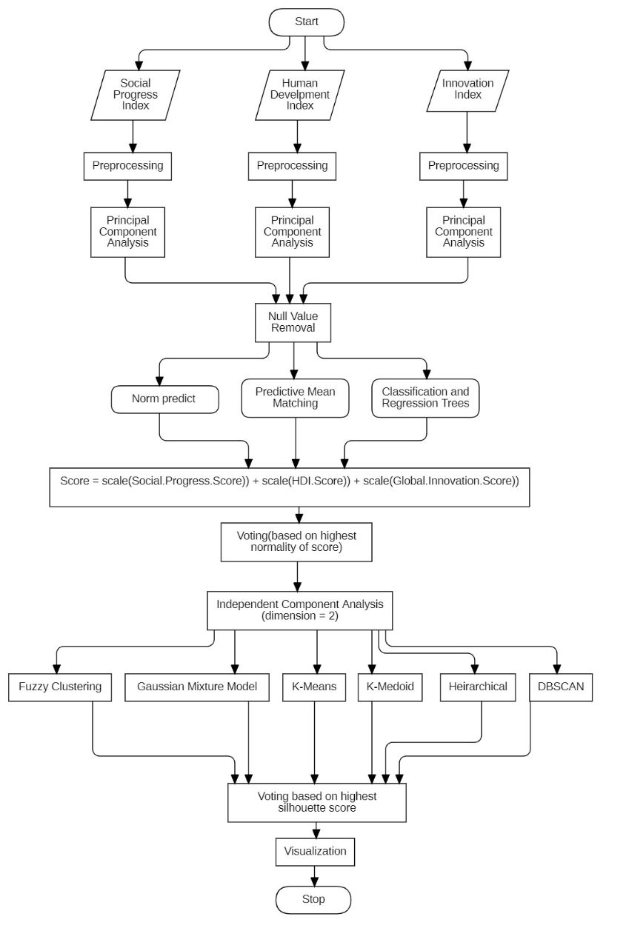
Methodology/Approach

Slide 7
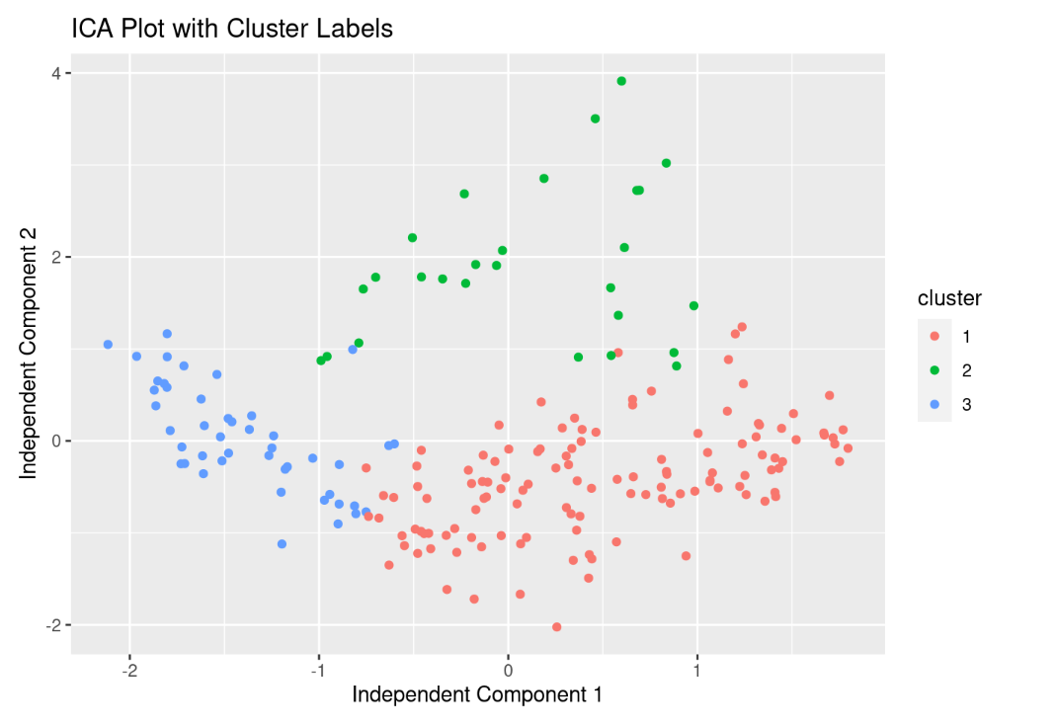
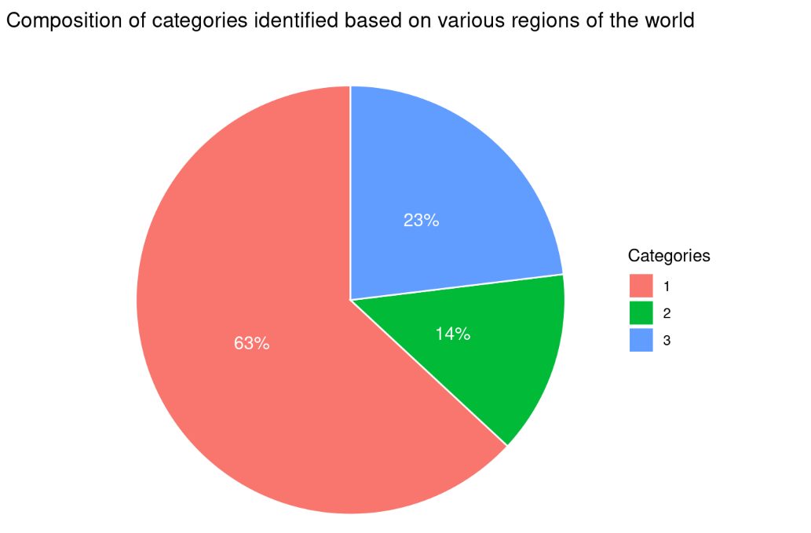
Experiment Results

Slide 8
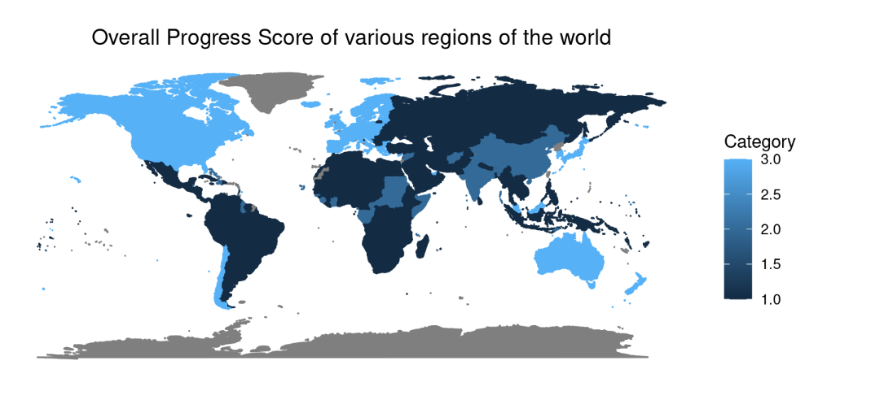
Experiment Results

Slide 9
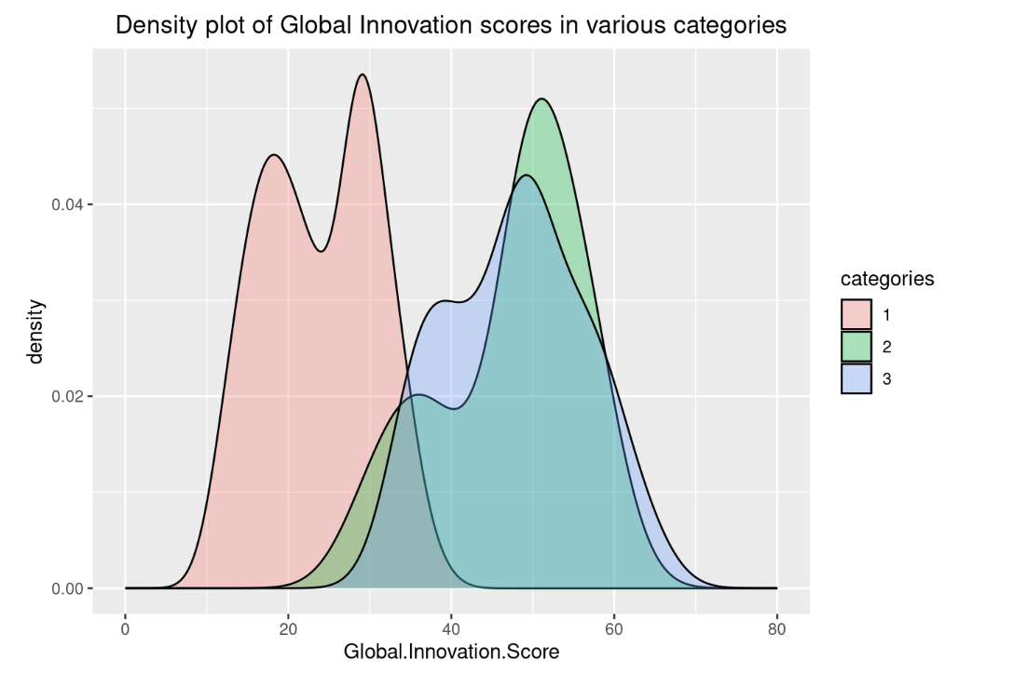
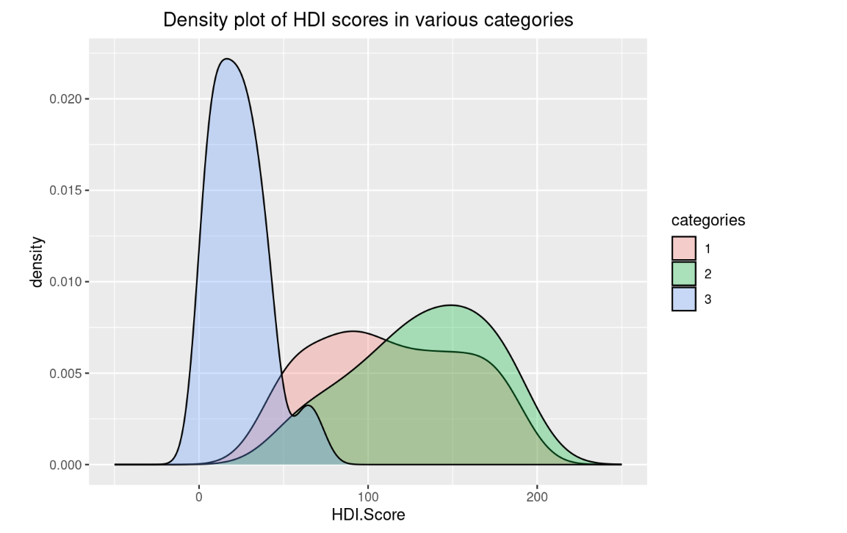
Experiment Results

Slide 10
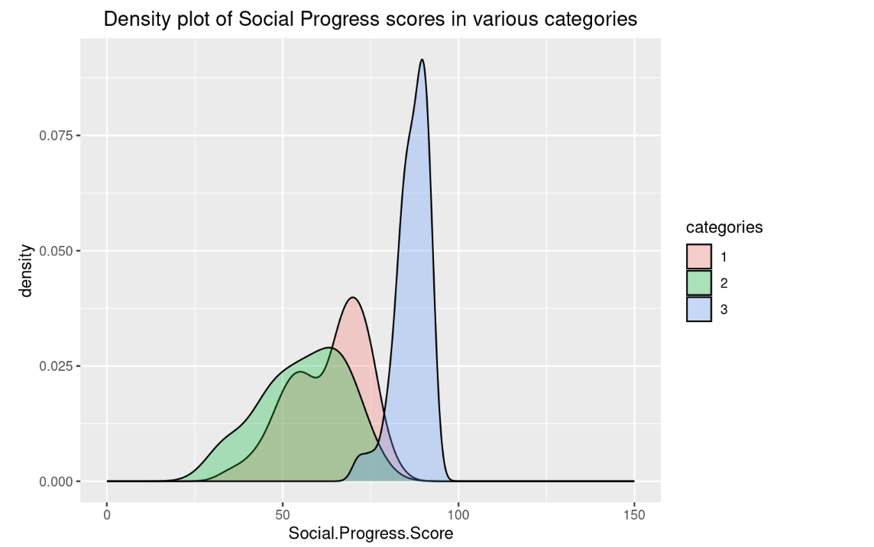
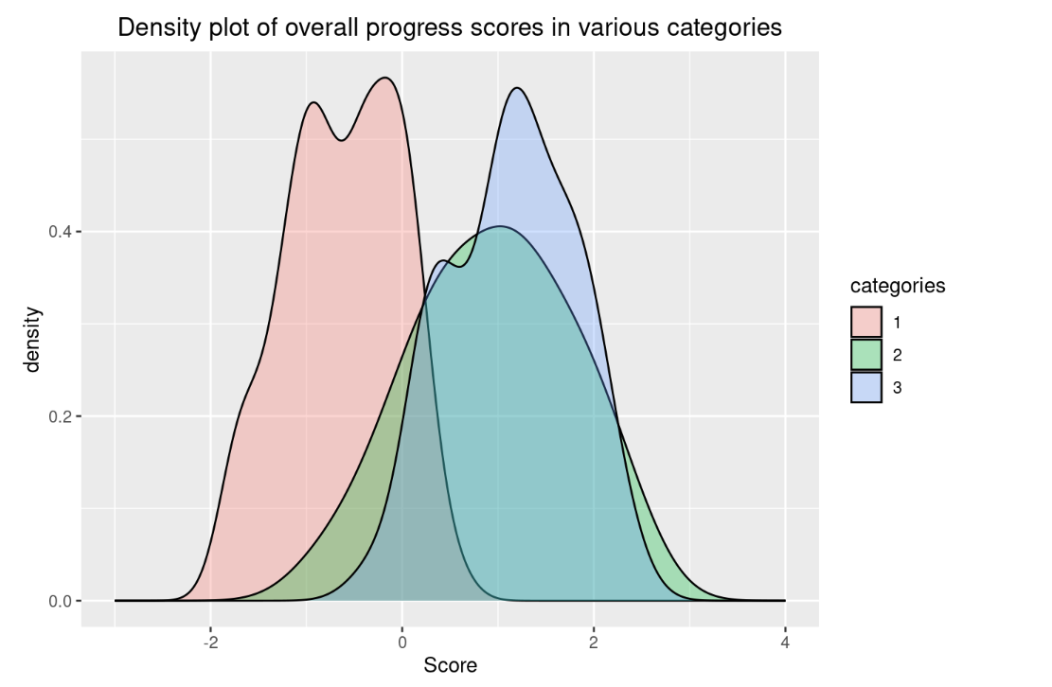
Experiment Results

Slide 11
Performance Analysis
After removal of NULL values using Norm Predict, Predictive Mean Matching and CART on the datasets and then applying Shapiro wilk test to obtain the following results.
We see that the P-value of dataset 3 is highest. Hence it, shall be selected for further computations
Dataset | W-Value | P-Value
1 | 0.9601 | 2.579e^-5
2 | 096102 | 3.237e^-5
3 | 0.9262 | 0.000276

Slide 12
Performance Analysis
Sl. No. | Clustering Technique | Silhouette Score
1 | K-Means | 0.486337
2 | Average Linkage | 0.4333979
3 | Complete Linkage | 0.4354677
4 | K-Medoid | 0.4683219
5 | GMM | 0.4542116
6 | DBSCAN | 0.416542
7 | Fuzzy Clustering | 0.462874

Slide 13
Conclusion
Countries ranked based on Social Progress Score, Human Development Score, and Global Innovation Score
Categorized into three clusters with a silhouette score of 0.48
Category 3: North America, Australia, New Zealand, Japan, South Korea, Europe, and Chile (higher scores, developed countries)
Category 2: India, China, South Sudan, Republic of Congo, Central African Republic (moderate scores, developing countries)
Category 1: most of Africa, South America, Central Asia, and Southeast Asia (low score, poor-performing countries)
PC1: highly dependent on Human Development Score and Social Progress Score
PC4: highly dependent on Global Innovation Score
PC32: highly dependent on Social Progress Score and Human Development Score
Categories dependent on PC1, PC4, and PC32 compared to principal components
Further exploration possible with the dataset based on 34 principal components, categories obtained, and overall score calculated.

Slide 14
References:
Social Progress Index
Global Innovation Index
Human Development Index

Slide 15
References
Development of a Holistic Index for Assessing the Sustainability of Rural Tourism
Development of a Holistic Index to Measure Social Sustainability of Urban Neighborhoods
A Holistic Approach to Sustainable Development: The Need for a New Economic Paradigm
Trends and Strategies towards Internalizing Higher Studies in India and developing a ranking based on that: A Case Study of Indian Universities
Development of a Holistic Ranking System for Sustainable Cities

Slide 16
Thank You

